Slide 1

Power & GDP- a link?
Nasal Amro, Prathan banga, daniel Froom, and Suleiman abdul samad
Project 1 - Group 3

Slide 2

Summary
Group 3
Is there a link between electricity production and GDP?
This fascinating question explores the links between power consumption, development, and economic productivity.
We attempt to use financial programming to answer this question, and explore the relationship between electrical production and GDP.
Nile River at night. Image credit: NASA

Slide 3
Did we find a Link?
Let’s have a look at Tableau

Slide 4

Data Sources and Methods
Group 3
EIA - US Energy Information Administration
BEA - US Bureau of Economic Analysis
Tableau
Pandas, Numpy, and Altair Libraries

Slide 5
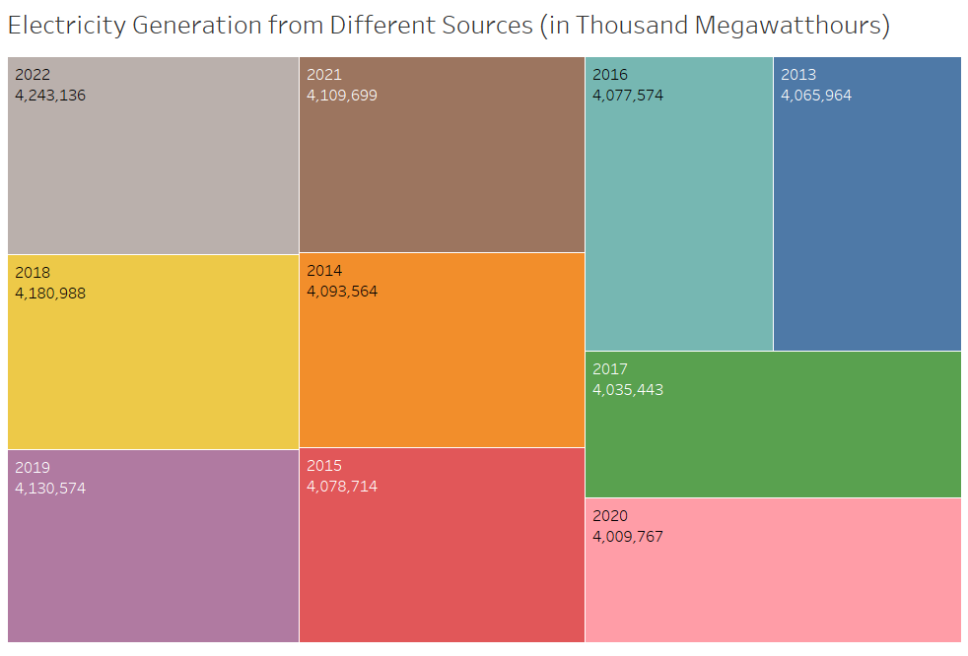
Caption

Slide 6
Thank you Pratham!

Slide 7
CORRELATION
Featuring Altair- Our new library.

Slide 8
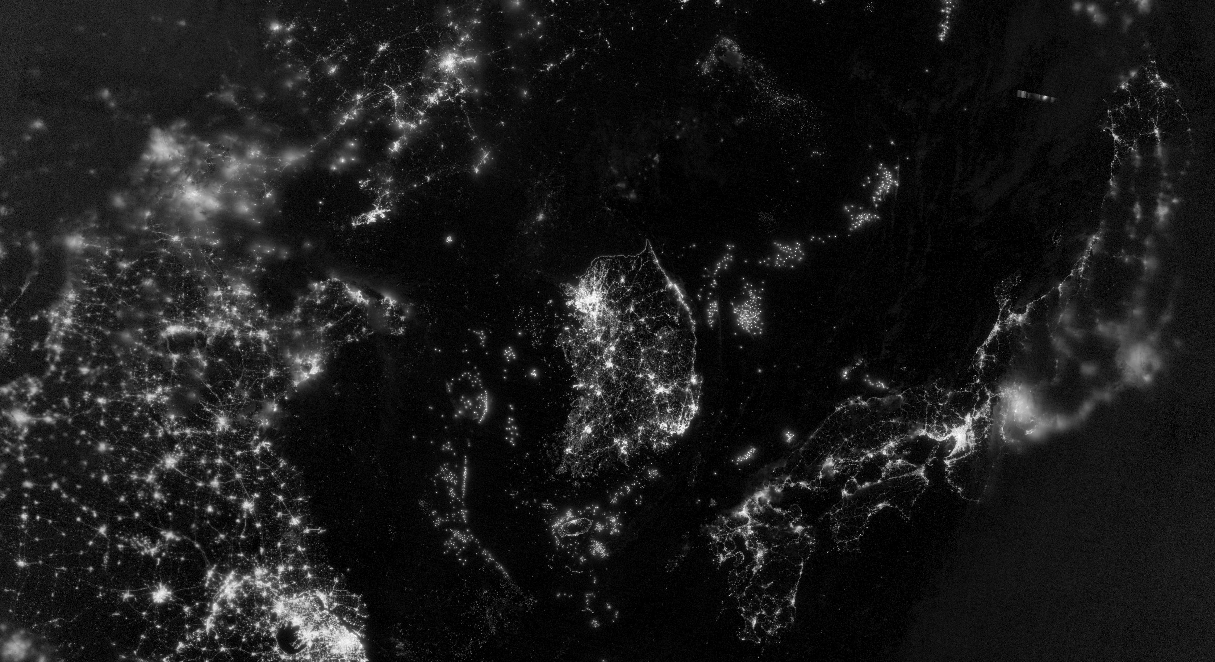
What about the rest of the world?
Group 3
Can anyone tell us what we are looking at?

Slide 9
Links
Group 3
Github:
Tableau:

Slide 10
Thank You!
It wouldn’t be much of a presentation without an audience…

